Slide 1
FLASK + AWS + SNOWFLAKE
Policy Document Intake
& Policy Intelligence
Serverless-first document intake, processing and analytics for insurance policy documents — Flask REST API, AWS event-driven pipeline and a Snowflake analytics layer.
Flask REST API
API Gateway
S3
EventBridge
Lambda + Textract
DynamoDB
SNS
Snowflake
Technical Deep Dive • Architecture, Data Flow & Implementation
Notes:
Title slide. Project: UseCasePOC — Policy Document Intake & Policy Intelligence (POC).

Slide 2






AGENDA
What this presentation covers
Problem & Solution
Architecture & Stack
Why policy document handling is slow, and what the POC builds
Five layers, one diagram, and the code-to-component map
Flask API Layer
AWS Intake & Processing
Endpoints, JWT auth, validation and error handling
API Gateway, S3, EventBridge, Lambda, DynamoDB, SNS, CloudWatch
Snowflake Platform
Quality & Roadmap
Loader, RAW / CURATED / ANALYTICS schemas and views
Security, cost, limitations and future scope
Policy Document Intake & Policy Intelligence
2

Slide 3
01 · PROBLEM
Manual document handling does not scale
Insurance operations depend on documents that are unstructured, scattered and hard to trace
Manual intake — agents and customer-service staff receive PDFs and images and must file, read and key in details by hand.
No single status view — a policyholder or agent cannot easily tell whether a document was received, processed or failed.
Unstructured content — policy numbers, dates and document type sit inside scanned pages rather than queryable fields.
Fragmented lookup — finding a policy or its documents means searching across separate stores with no audit trail.
POC GOAL
Upload → Extract → Track → Analyze
One automated path from a policy document to a searchable, auditable record — built on free-tier-conscious, serverless services.
Policy Document Intake & Policy Intelligence
3

Slide 4

02 · SOLUTION
Three ideas power the platform
An event-driven pipeline replaces manual triage from upload to analytics
Serverless intake
Event-driven
Snowflake analytics
Flask hands validated documents to API Gateway, which writes them to S3 through a native S3 proxy integration — no upload Lambda, no always-on file server.
An S3 Object Created event reaches EventBridge, which invokes a Lambda that runs Textract, classifies the document type and extracts key policy fields.
Processed records are loaded into RAW and CURATED tables. Views expose search, dashboard and audit datasets for policy lookup and reporting.
Policy Document Intake & Policy Intelligence
4

Slide 5
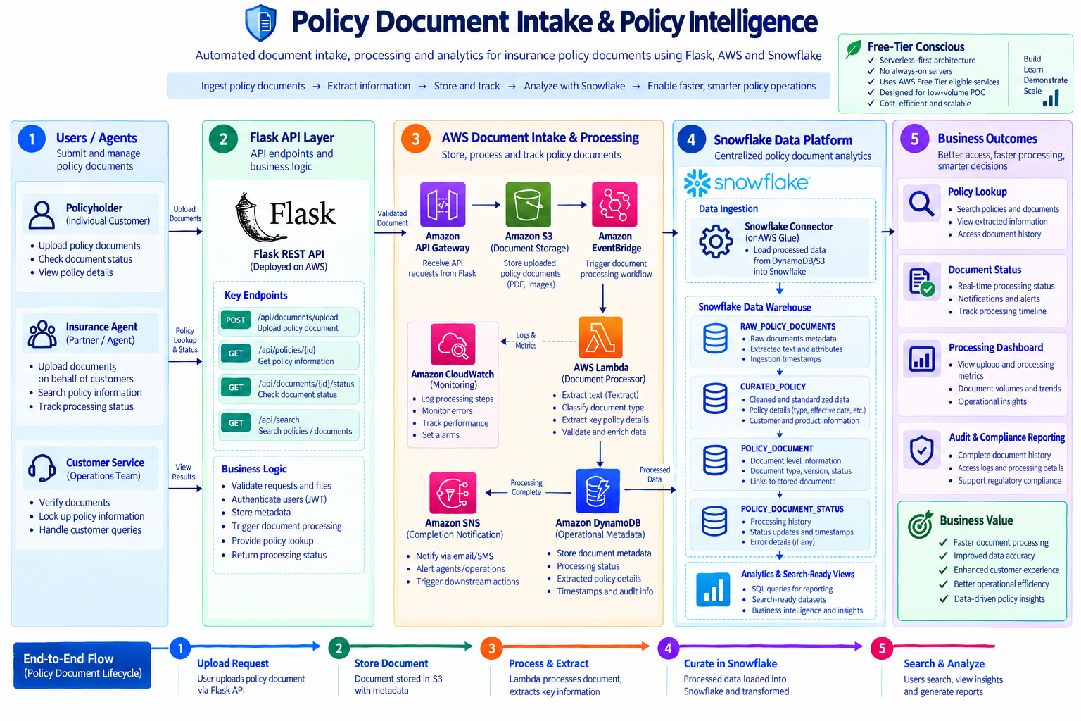
03 · SYSTEM ARCHITECTURE
The full picture: five connected zones
1
Users / Agents
Policyholder, Insurance Agent, Customer Service
2
Flask API
REST endpoints + business logic
3
AWS pipeline
API GW → S3 → EventBridge → Lambda → DynamoDB / SNS
4
Snowflake
Ingestion + RAW / CURATED / analytics
5
Outcomes
Lookup, status, dashboard, audit
Policy Document Intake & Policy Intelligence
5
Notes:
The architecture image is the project's own diagram (1.Policy.png). The repository implements each numbered zone; see the code-to-architecture map on the next slide.

Slide 6
04 · EXECUTION WORKFLOW
One document, eight stages
From login to searchable record
1
Authenticate
2
Validate & upload
3
Store in S3
4
Trigger
POST /api/auth/login issues an HS256 JWT
Flask checks file + customer_id, PUTs to API Gateway, writes UPLOADED to DynamoDB
Object lands at incoming/<customer>/<doc_id>_<file>
S3 Object Created → EventBridge rule → Lambda
5
Process
6
Track & notify
7
Load
8
Query
Textract text → classify (AUTO / HOME / LIFE / UNKNOWN) → regex fields
DynamoDB set to PROCESSED; SNS completion message
Loader Lambda reads DynamoDB, INSERTs RAW, MERGEs CURATED_POLICY
Policy lookup, search and status through Flask
Client / Flask
AWS
Snowflake
Outcomes
Policy Document Intake & Policy Intelligence
6

Slide 7
STEPS 2–3 · UPLOAD PATH
Flask → API Gateway → S3
Flask never writes to S3 itself; API Gateway performs the PutObject
Flask
→
API Gateway
→
Amazon S3
upload_document()
PUT /documents/{proxy+}
policy-documents-poc
Step 2 — Hand-off: aws_service.upload_document_via_api_gateway() generates a UUID4 document_id and the key incoming/{customer_id}/{document_id}_{filename}, then PUTs the bytes to API_GATEWAY_UPLOAD_URL with a 30 s timeout.
Step 3 — Proxy: API Gateway uses an AWS-service integration (type AWS) with the ApiGatewayS3ProxyRole, scoped to s3:PutObject on incoming/* only.
Record: after a successful PUT, Flask writes the initial item to DynamoDB (status UPLOADED, document_type UNKNOWN) and returns 202.
Failure: any requests exception becomes 502 upstream_service_error.
EXAMPLE OBJECT KEY
incoming/CUST-001/
3f2a…9c1e_CUST-001_POL-1001_auto.pdf
Bucket has EventBridge notifications enabled.
1 Auth
2 Upload
3 S3
4 Event
5 Process
6 Notify
7 Load
8 Query
Policy Document Intake & Policy Intelligence
7

Slide 8
STEPS 4–5 · EVENT & PROCESSING
EventBridge → Lambda Document Processor
Diagram: extract text, classify document type, extract key policy details
EventBridge rule: policy-document-uploaded-rule
Extract text
1
source aws.s3 · detail-type Object Created · bucket policy-documents-poc · key prefix incoming/ → target policy-document-processor
Textract detect_document_text on the S3 object; LINE blocks joined
Classify
2
KEYWORD CLASSIFIER (DOC_TYPE_KEYWORDS)
keyword match → AUTO_POLICY, HOME_POLICY, LIFE_POLICY or UNKNOWN
AUTO_POLICY: vehicle, auto insurance, vin
HOME_POLICY: homeowners, dwelling,
property insurance
LIFE_POLICY: life insurance, beneficiary
Extract fields
3
regex for policy number, effective date; 500-char text excerpt
POC-grade extraction: heuristic keywords and regex, not a trained model. On error the item is set to FAILED with error_details and the exception is re-raised.
Persist & notify
4
DynamoDB update_item → PROCESSED; SNS publish
1 Auth
2 Upload
3 S3
4 Event
5 Process
6 Notify
7 Load
8 Query
Policy Document Intake & Policy Intelligence
8

Slide 9



STEP 6 · TRACK & NOTIFY
DynamoDB, SNS and CloudWatch
Operational metadata, completion events and monitoring
Amazon DynamoDB
Amazon SNS
Amazon CloudWatch
Table PolicyDocumentProcessing, key document_id, PAY_PER_REQUEST. Holds customer_id, policy_id, s3_key, status, document_type, extracted_data, error_details. Flask writes UPLOADED; the processor updates PROCESSED / FAILED.
Topic policy-document-notifications. Processor publishes a document.processed message. Subscribers: ops email and the Snowflake loader Lambda (protocol lambda).
Lambda logs carry structured lines such as processing_start / processing_complete with document_id for Logs Insights. One alarm, document-processor-errors, fires when Errors ≥ 1 in 5 minutes.
STATUS LIFECYCLE IN DYNAMODB
Diagram mentions email/SMS alerts: setup commands show an email subscription only; SMS is not clearly present.
UPLOADED
→
PROCESSED
or
FAILED
1 Auth
2 Upload
3 S3
4 Event
5 Process
6 Notify
7 Load
8 Query
Policy Document Intake & Policy Intelligence
9

Slide 10

STEP 7 · SNOWFLAKE INGESTION
SNS-triggered Snowflake Loader Lambda
Diagram: “Snowflake Connector (or AWS Glue)” — the connector option is implemented
SNS
→
Loader Lambda
→
DynamoDB
→
Snowflake
completion message
policy-snowflake-loader
get_item(document_id)
RAW + CURATED
Trigger: one SNS record per completed document.
Read-back: full item fetched from DynamoDB rather than trusting the message body.
Two statements: INSERT into RAW (extracted_data as VARIANT), MERGE into CURATED_POLICY keyed on policy_id.
Design choice: AWS Glue not used — noted in the code as an Implementation Assumption for cost and simplicity.
Credentials: read from Lambda environment variables.
SQL EXECUTED BY THE LOADER (SIMPLIFIED)
INSERT INTO RAW_POLICY_DOCUMENTS
(document_id, customer_id, policy_id,
s3_key, document_type, status,
extracted_data, ingested_at)
SELECT %(document_id)s, …,
PARSE_JSON(%(extracted_data)s),
CURRENT_TIMESTAMP();
MERGE INTO CURATED_POLICY tgt USING (…) src
ON tgt.policy_id = src.policy_id
WHEN MATCHED THEN UPDATE …
WHEN NOT MATCHED THEN INSERT …
1 Auth
2 Upload
3 S3
4 Event
5 Process
6 Notify
7 Load
8 Query
Policy Document Intake & Policy Intelligence
10

Slide 11
07 · SNOWFLAKE DATA PLATFORM
Three schemas, four tables, three views
Warehouse POLICY_WH: XSMALL, AUTO_SUSPEND 60 s, AUTO_RESUME, initially suspended
RAW
CURATED
ANALYTICS
Landing & history
Clean, query-ready
Search-ready views
RAW_POLICY_DOCUMENTS
document_id, customer_id, policy_id, s3_key, document_type, status, extracted_data (VARIANT), ingested_at
POLICY_DOCUMENT_STATUS
document_id, status, event_timestamp, error_details
CURATED_POLICY
policy_id (PK), customer_id, policy_type, product_name, effective_date, status, updated_at
POLICY_DOCUMENT
document_id (PK), policy_id, customer_id, document_type, version, status, s3_key, updated_at
POLICY_DOCUMENT_SEARCH_VIEW
concatenated search_text over POLICY_DOCUMENT
PROCESSING_DASHBOARD_VIEW
counts by document_type, status, day
AUDIT_TRAIL_VIEW
status events over POLICY_DOCUMENT_STATUS
Policy Document Intake & Policy Intelligence
11

Slide 12
08 · WORKED EXAMPLE
Tracing one document end to end
Illustrative trace based on the README scenario and the sample file CUST-001_POL-1001_auto.pdf
1
Upload
2
S3 + event
3
Processor
POST /api/documents/upload
file + customer_id=CUST-001
→ 202, status UPLOADED
incoming/CUST-001/
<uuid>_CUST-001_POL-1001_auto.pdf
Object Created → EventBridge
Textract text; “vehicle / auto
insurance / vin” match →
AUTO_POLICY; regex fields
4
DynamoDB + SNS
5
Snowflake
6
Query
status PROCESSED
document_type AUTO_POLICY
SNS document.processed
INSERT RAW row
MERGE CURATED_POLICY
(status ACTIVE)
GET /api/documents/{id}/status
GET /api/policies/{id}
GET /api/search?q=CUST-001
Actual run outputs are not part of the provided project materials; this trace follows the code path, not recorded results.
Policy Document Intake & Policy Intelligence
12

Slide 13


09 · SECURITY, COST & DEPLOYMENT
Built for a low-volume, free-tier-conscious POC
Security
Cost control
Deployment
IAM policies scoped per role in aws/iam/*.json
JWT on all data routes; no secrets committed (.env ignored)
No tokens or passwords written to logs
Gaps: password-less login, no HTTPS or CORS config, no magic-byte file checks, API Gateway method has no authorizer
DynamoDB PAY_PER_REQUEST
Snowflake XSMALL, AUTO_SUSPEND 60 s, AUTO_RESUME
API Gateway → S3 proxy avoids an upload Lambda
Lambdas: 256 MB, 30 s timeout
Dockerfile: python:3.12-slim + Gunicorn (2 workers)
Procfile for platform deploys
Documented path: Elastic Beanstalk, single t3.micro
Not yet deployed — README leaves this unchecked
Policy Document Intake & Policy Intelligence
13

Slide 14
10 · FUTURE SCOPE & CONCLUSION
A working blueprint from upload to analytics
Delivered in the POC
Future scope (not implemented)
Flask REST API with JWT, validation, error handling
Serverless intake: API Gateway → S3 → EventBridge
Lambda + Textract processing, DynamoDB tracking, SNS
Snowflake RAW / CURATED / ANALYTICS design and views
Fix schema handling and populate all four tables in the loader
Expose dashboard and audit routes; trained or query-based extraction
End-to-end tests on real AWS and Snowflake; HTTPS + CORS
Thank you
Policy Document Intake & Policy Intelligence

